Slide 1
Share Your Crop An application for sharing information about raising crops
By: Austin Yuille

Slide 2
Introduction
Agricultural advancements have led to the introduction of many new faming techniques such as hydroponics.
This has led to some questions being raised as to what method is the most efficient and which method brings in the most profit.
In order to answer these questions, there needs to be a spot for farmers to contribute their data for analysis. Meet Share Your Crop.

Slide 3
Topic
Share Your Crop is an application that allows for the entry and viewing of various data related to basic farming.
The idea behind the application is that if a farmer grows a crop, then they can insert the information pertinent to the growing of it, such as what seeds and fertilizer they used.
Then when they sell the crop, they can also enter the information related the sale of it, such as how much they sold and for how much.
Then other farmers can look at this information and determine if they want to start growing crops this way.

Slide 4
Scope
The current state of Share Your Crop only looks the data for 20 farms. However, the application could easily be scaled out to hold the data for more.
There are 3 tables that are fixed and can not have data added to them, these are the tables containing information directly related to seeds, fertilizers, and farms. This is because this information is not influenced by the actions of existing farmers that use the app.
The other 4 tables can have data added to them, and they contain data about greenhouses, fields, crops, and sales.
Some examples of data that might be included in these tables are if a greenhouse is capable of hydroponics or how many acres a field is.

Slide 5




Implementation
Python and Flask for functionality
HTML for web interface
Bootstrap for interface styling
MySQL for database creation and management

Slide 6
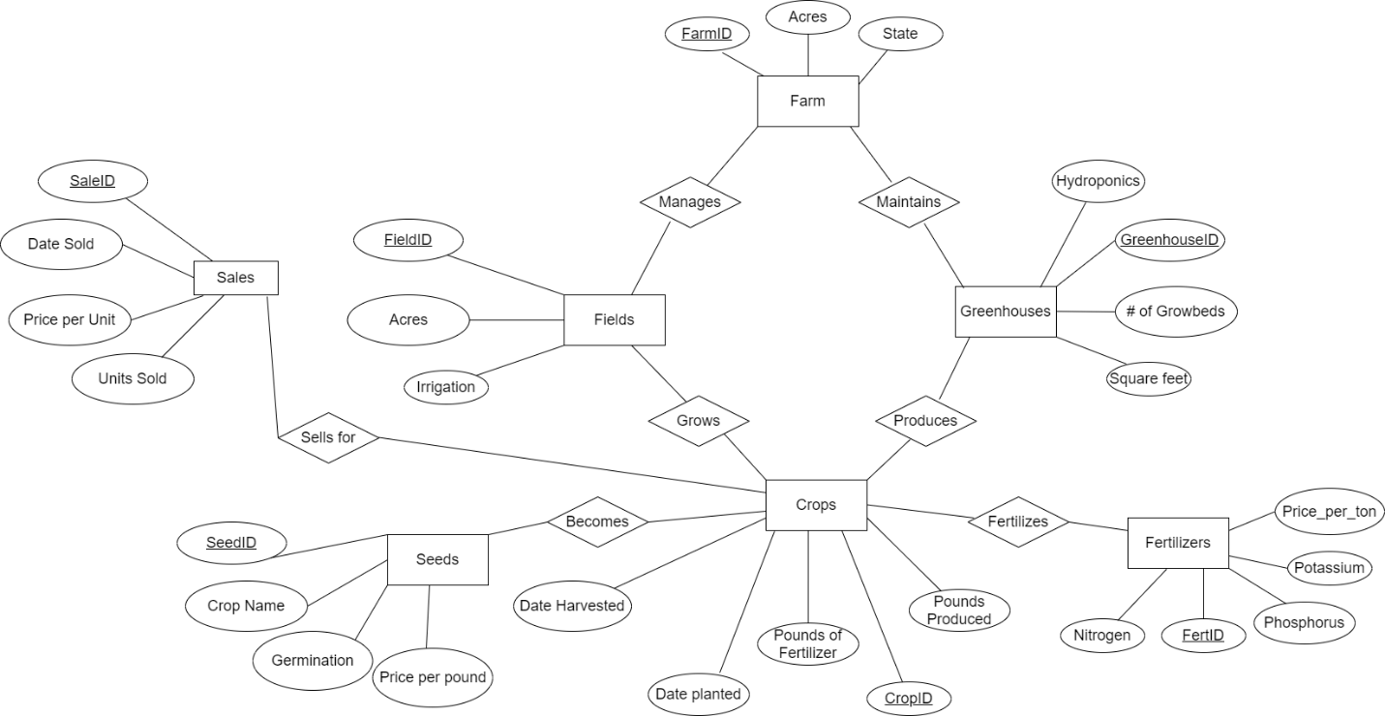
ER Diagram

Slide 7
Uses cases
Use case #1
A farmer grows a corn crop in a new field without using any fertilizer. After harvesting the crop, he sells 20 ears of it for 50 cents an ear. Now, he can go open Share My Crop enter in the acreage and irrigation type of his new field. He can enter how many pounds of corn was produced, when he planted it, when he harvested it, what field he grew it in, and what type of seed he used. Then he can enter what crop he sold at the market, how much he sold each unit for and how many units he sold.
Use case #2
Another farmer is wanting to start growing corn. He opens Share My Crop and sorts the seed table by crop name. He then uses this information in the crop table to find all crops that use corn seeds and determines which seed he wants to use and if he wants to grow it in a field or a greenhouse.

Slide 8
Conclusion
Moving forward, I would add some joined tables to keep users from having to swap between tables so often.
Also, I would like to use real-world data. There were some features that I couldn’t implement due to the way the data was generated.

